Slide 1
The Gamma and Normal Distributions
3.2, 3.3

Slide 2

The Gamma Distribution
Consider a Poisson process with rate $λ:$
Let a random variable, $X$, denote the waiting time until the $α$th occurrence.
$X$ follows a Gamma Distribution.

Slide 3
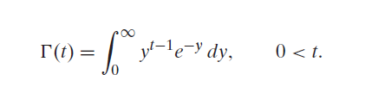
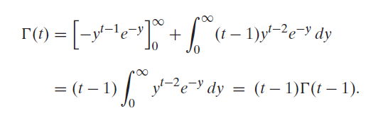



The Gamma Function, $Γ$
This is the definition of the gamma function
When n is an integer,

Slide 4


Gamma Distribution X~Gamma($α,θ)$
$f\left(x\right)= \frac{1}{Γ(α)θ^{α}}x^{α−1}e^{−x/θ}$, 0 $≤$ x < $∞$
$$E[X] = αθ$$
$$Var[X] = αθ2$$

Slide 5

Gamma Example
Customers arrive in a shop according to a Poisson process with a mean rate of 20 per hour. What is the probability that the shopkeeper will have to wait more than 10 minutes for the arrival of the 4th customer?
$$\int_{10}^{∞}{\frac{1}{Γ\left(4\right)3^{4}}x^{4−1}e^{−x/3}}dx=0.57$$

Slide 6
Normal Distribution

Slide 7
Normal Distribution
Most important distribution in statistics
Fits many natural phenomena such as IQ, measurement error, height, etc.
A symmetric distribution with a central peak, and tails that taper off.

Slide 8
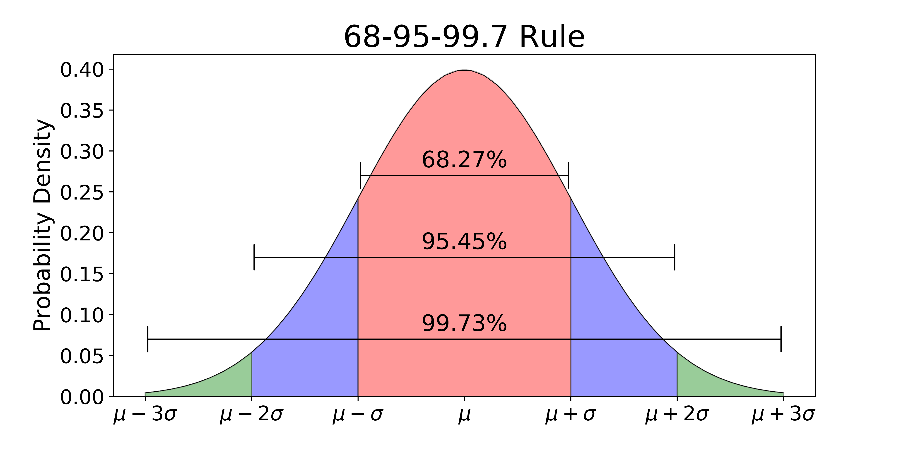
Normal Distribution – Empirical Rule
In a normal distribution, approximately 68/95/99.7% of the data falls within 1/2/3 standard deviations of the mean.

Slide 9


Normal Distribution X~N($μ,σ^{2}$)
$f(x)$= $\frac{1}{\sqrt{2πσ^{2}}}e^{−\frac{{(x−μ)}^{2}}{{2σ}^{2}}}$, -$∞<x<∞$
$E[X] =$ $μ$
$$Var[X] = σ^{2}$$

Slide 10

Normal Distribution
Let X ~ Normal$(μ,σ^{2})$
To find the P[a < X < b], one would need to evaluate the integral:
$$\int_{a}^{b}{\frac{1}{\sqrt{2πσ^{2}}}e^{−\frac{{(x−μ)}^{2}}{{2σ}^{2}}}dx.}$$
A closed-form expression for this integral does not exist, so we need to use numerical integration techniques.

Slide 11

Notes about the Normal Distribution
The Normal Distribution is symmetric with a central peak:
P[X > c] = P[X < -c]
Mean = Median = Mode
Half of the area is to the left/right of 0.
Examples: if $X \sim N(0,1)$
$P[X ≤ 0.2] = 0.5 + P[0 ≤ X ≤ 0.2]$
$P[X ≤ 0.3] = P[X ≥ 0.7]$

Slide 12

Examples
Let $Z \sim N(0,1)$
Find P[Z >2] (0.0228)
Find P[ -2 < Z < 2] (0.9544)
Find P[0 < Z < 1.73] (0.4582)

Slide 13

Linear Transformation Theorem
Let X ∼ N(µ, σ²). Then Y = αX + β follows also a normal distribution.
$Y$ ∼ $N$(αµ+β, α²σ²)
Can convert any normal distribution to standard normal by subtracting mean and dividing sd:
Z = $\frac{X−μ}{σ}$
Using this theorem, we can see that $Z \sim N(0,1)$
(Recall) Let $X$ have mean, $E[X]$, and variance, $σ^{2}$.
Let Y = $aX+b$. Then, $Y$ has mean $aE[X]+b$, and variance $a^{2}σ^{2}$.

Slide 14

Example
Suppose the mass of Thor’s hammers in kg (he has an infinite number) are distributed X ∼ N(10, 3²).
Find the proportion of Thor’s hammers that have mass larger than 13.4 kg. (if we randomly select a hammer, find the probability that its mass > 13.4 kg).
ans. P[X > 13.4] = P[Z > 1.13] = 0.1292

Slide 15
What is z?
The value of z gives the number of standard deviations the particular value of X lies above or below the mean µ.

Slide 16
Examples
Normal Distribution

Slide 17
1
Cream and Fluttr knows that the daily demand for cupcakes is a random variable which follows the normal distribution with mean 43.3 cupcakes and standard deviation 4.6. They would like to make enough so that there is only a 5% chance of demand exceeding the number of cupcakes made. (How many should they make?)
z=1.645 x = 51

Slide 18

2
Suppose again that Thor’s hammers are normally distributed with: E[X] = 10, Var[X] = 9.
Find the 25th percentile of X. (How much mass should a hammer have, in order to have more than 25% of all hammers)
Ans. z = -0.675 $π$_{0.25} = 7.975

Slide 19


3
Stapleton’s Auto Park of Urbana believes that total sales for next month will follow the normal distribution, with mean, $μ$, and a standard deviation,$σ$= $300,000. What is the probability that Stapleton’s sales will fall within $150000 of the mean next month?
Ans. 0.6915 − 0.3085 = .383

